Slide 1
Research design
Research design is blueprint of the research process.
Research design is the methods and procedures for acquiring the information needed to find the answers of problems

Slide 2
Types of research design
Exploratory research
When research problem is very ambiguous
Degree of uncertainty of research problem is very high
Ex. “Sales of our product has declined”
Descriptive research
In descriptive research problems are fairly defined.
Some thing extra is described about the problem
Ex. “ sales of our product decline because of poor distribution activities ”
Causal research
cause and effect relationship exits here
Ex. “ 10% decrease in price will increase sales by what %”

Slide 3
Tools used to conduct Exploratory research

Slide 4
Literature Review
Personal interview
Skilled interviewer is required
Most questions are open ended
Focus group
8 to 12 people are called
Topic is introduced to them
Moderator is required who monitor this group

Slide 5
Projective technique
Word association :
Respondent is given series of words and asked to tell first thing which comes to his mind about that word
Time and frequency of the answer is most important parameter to know feeling of the person about that word
If some body does not give any answer it mean he is very emotionally involved in that thing it blocks him to respond

Slide 6
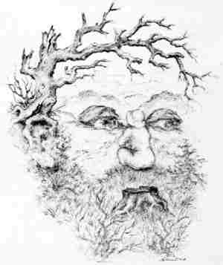
Projective technique Storytelling

Slide 7
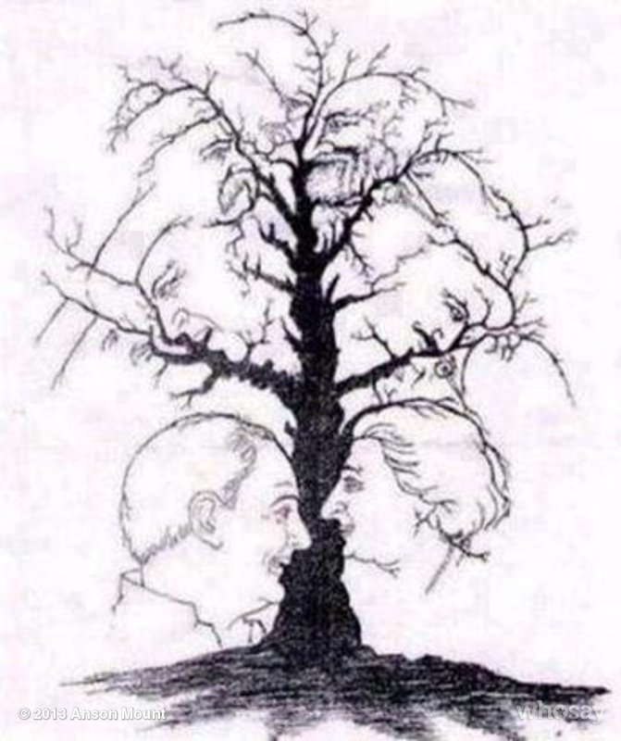

Slide 8
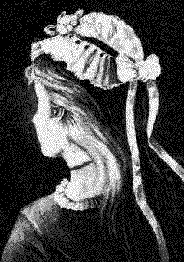

Slide 9
Sentence completion
Third person technique / Role play
Collage
Music association
Anthropromorphicizing

Slide 10
Tools to conduct descriptive research
Cross sectional design
A cross-sectional design involves the collection of information from any given sample of population elements only once
Longitudinal design
In a longitudinal design, a fixed sample (or samples) of population elements is measured repeatedly on the same variables

Slide 11
Figure 3.6 Cross Sectional vs. Longitudinal Designs
Cross Sectional vs. Longitudinal Designs
Sample Surveyed at T₁
Cross Sectional Design
Same Sample also Surveyed at T₂
Sample Surveyed at T₁
Longitudinal Design
Time
T₁
T₂

